Slide 1



Introduction to ISO/IEC software engineering standards
Education Interest Group
Network of Centers to support VSEs
ISO/IEC JTC1/SC7 Working Group 24

Slide 2
Description
It provides an introduction to the family of ISO/IEC Software Engineering Standards and describes the relationships between software engineering and systems engineering standards.

Slide 3
Course Topics
Why are Standards so important?
What is ISO/IEC?
What ISO/IEC Standards are available?
ISO 9000
ISO 12207
ISO 15504

Slide 4
Why standards?
Quality orientated process approaches and standards are maturing and gaining acceptance in many companies
Standards emphasize communication and shared understanding
  For example: if one person says, “Testing is complete”, will all affected bodies understand what those words mean?
This kind of understanding is not only important in a global development environment; even a small group working in the same office might have difficulties in communication and understanding of shared issues
Standards can help in these and other areas to make the business more profitable because less time is spent on non-productive work

Slide 5
Benefits
The use of standards has many potential benefits for any organization
  Improved management of software
    Schedules and budgets are more likely to be met
    Quality goals are likely to be reached
    Employee training and turnover can be managed
  Visible certification can attract new customers or be required by existing ones
  Partnerships and co-development, particularly in a global environment, are enhanced

Slide 6
More business benefits
Regulation
  Cost effective compliance
  Customer assurance
  Reduce product liability
  Risk management
  Governance
Cost Optimization
  Reduced transaction costs
  Product/process interoperability
  Flexibility in supply chain
  Best practice & management systems
Maximizing Revenue
  Improve speed to market
  Product acceptance
  Product life cycle management
Business Opportunities
  Develop new markets & future sales
  Influence technology change
  Influence industry evolution
  Structure regional/international competition

Slide 7
Importance of standards
Encapsulation of best practice
  avoids repetition of past mistakes
Framework for quality assurance process
  it involves checking standard compliance
Provide continuity
  new staff can understand the organisation by the standards applied

Slide 8
Problems with standards
There is evidence that the majority of small software organizations are not adopting existing standards as they perceive them as being orientated towards large organizations.
Studies have shown that small firms’ negative perceptions of process model standards are primarily driven by negative views of cost, documentation and bureaucracy
It has been reported that VSEs find it difficult to relate standards to their business needs and to justify the application of the international standards in their operations

Slide 9
Course Topics
Why are Standards are important?
What is ISO/IEC?
What ISO/IEC Standards are available?
ISO 9000
ISO 12207
ISO 15504

Slide 10
Who is the ISO?
International Organization for Standardization is the world's largest developer of International Standards
ISO is a network of the national standards institutes of 162 countries, one member per country
ISO is a non-governmental organization that forms a bridge between the public and private sectors
  Many of its member institutes are part of the governmental structure of their countries, or are mandated by their government
  Other members have their roots uniquely in the private sector, having been set up by national partnerships of industry associations
This enables ISO to reach a consensus on solutions that meet both the requirements of business and the broader needs of society

Slide 11
Who develops ISO standards
ISO standards are developed by technical committees, (or subcommittees) comprising experts from the industrial, technical and business sectors
These experts may be joined by representatives of government agencies, consumer associations, non-governmental organizations and academic circles, etc.
Experts participate as national delegations, chosen by the ISO national member body for the country concerned.

Slide 12
How ISO standards are developed
The national delegations of experts of a committee meet to discuss, debate and argue until they reach consensus on a draft agreement
The resulting document is circulated as a Draft International Standard (DIS) to all ISO's member bodies for voting and comment
If the voting is in favor, the document, with eventual modifications, is circulated to the ISO members as a Final Draft International Standard (FDIS)

Slide 13
ISO Membership
Information about ISO, in general, is available on ISO Online (www.iso.org)
While a good deal of publicly accessible information concerning the technical work of the organization is maintained on the ISO TC Portal (www.iso.org/tc)

Slide 14
ISO/IEC outline Structure
ISO
IEC
UN/ITU-T
CS/ITTF
TC176
JTC 1
TC56
SC65A
Quality Management Information Technology Dependability Functional Safety
SC6
SC7
SC27
SC37
Telecommunications
Systems & Software Engineering
IT Security
Techniques
Biometrics
ISO International Organization for Standardization
IEC International Electrotechnical Commission
ITTF Information Technology Task Force
CS Central Secretariat
UN United Nations
ITU-T International Telecommunications Union
TC Technical Committee
SC Sub Committee
JTC Joint Technical Committee
WG Working Group
WGs

Slide 15
Subcommittees (SC) of ISO/IEC JCT1
Technical Directions | JTC1 Subcommittees and Working Groups
Application Technologies | SC 36 - Learning Technology
Cultural and Linguistic Adaptability & User Interfaces | SC 02 - Coded Character Sets SC 22/WG 20 – Internationalization SC 35 - User Interfaces
Data Capture land Identification Systems | SC 17 - Cards and Personal Identification SC 31 - Automatic Identification and Data Capture Techniques
Data Management Services | SC 32 - Data Management and Interchange
Document Description Languages | SC 34 - Document Description and Processing Languages
Information Interchange Media | SC 11 - Flexible Magnetic Media for Digital Data Interchange SC 23 - Optical Disk Cartridges for Information Interchange
Multimedia and Representation | SC 24 - Computer Graphics and Image Processing SC 29 - Coding of Audio, Picture, Multimedia, Hypermedia Information
Networking and Interconnects | SC 06 - Telecommunications and Information Exchange Between Systems SC 25 - Interconnection of Information Technology Equipment
Office Equipment | SC 28 - Office Equipment
Programming Languages & Software Interfaces | SC 22 - Programming Languages, their Environments & Systems Software Interfaces
Security | SC 27 - IT Security Techniques
Software Engineering | SC 07 - Software and System Engineering
Biometrics | SC 37 - Biometrics

Slide 16
ISO/IEC JTC 1 SC7
ISO/IEC JTC 1 SC7
  International Organization for Standardization/ International Electrotechnical Commission Joint Technical Committee 1 Sub-Committee 7
ISO/IEC JTC 1 SC7 Terms of Reference
  “Standardization of processes, methods and supporting technologies for the engineering and management of software and systems throughout their life cycles”

Slide 17
SC7 Structure
SWG 5
SWG 1
Standards Management Group
SC7
Business Planning Group
Secrétariat
WG1A
WG7
WG21
WG25
IT Governance
Life Cycle
Management
Software
Asset Management
IT Service
Management
WG2
WG10
WG22
WG26
Systems & Software
Documentation
Process
Assessment
Vocabulary
Software Testing
WG4
WG19
WG23
WG42
Tools and
Environment
Techniques for
Specifying IT Systems
Systems Quality
Management
Architecture
WG6
WG20
WG24
JWG ISO/TC 54
Software Product
Measurement and
Evaluation
Software Engineering
Body of Knowledge
SLC Profiles and
Guidelines for VSEs
CIF Usability
‡ Adapted from Prof. M. Azuma

Slide 18
Working Group 24
ISO/IEC JTC1/SC7 WG 24, Life Cycle Processes for Very Small Entities
ISO 29110
The goal of Working Group 24, to:
  “develop profiles, guides, and examples to assist very small enterprises to become more competitive”
WG24 is planning to develop several products to give small entities a better opportunity to develop high-quality products on time and to make a profit in the process.
Creating an overview, framework, profile, and taxonomy, leading to a standard that will enable development of guides for engineering, management, and assessment

Slide 19
Course Topics
Why are Standards are important?
What is ISO/IEC?
What ISO/IEC Standards are available?
ISO 9000
ISO 12207
ISO 15504

Slide 20
What ISO/IEC Standards are available?
There are a large collection of standards covering a range of domains
For example:
  ISO 9126 for the evaluation of software quality
  ISO 20926 a functional size measurement method
  ISO 26513 for testers and reviewers of user documentation

Slide 21
Domains covered by SC7
Industrial
Engineering
Quality
Management
(ISO TC 176)
Project
Management
SOFTWARE and SYSTEMS
ENGINEERING
APPLICATION
DOMAINS
(many TCs)
Computer
Sciences and
Engineering
Dependability
Engineering
(IEC TC 56)
Safety
(IEC TC65),
Security, other
mission-critical

Slide 22
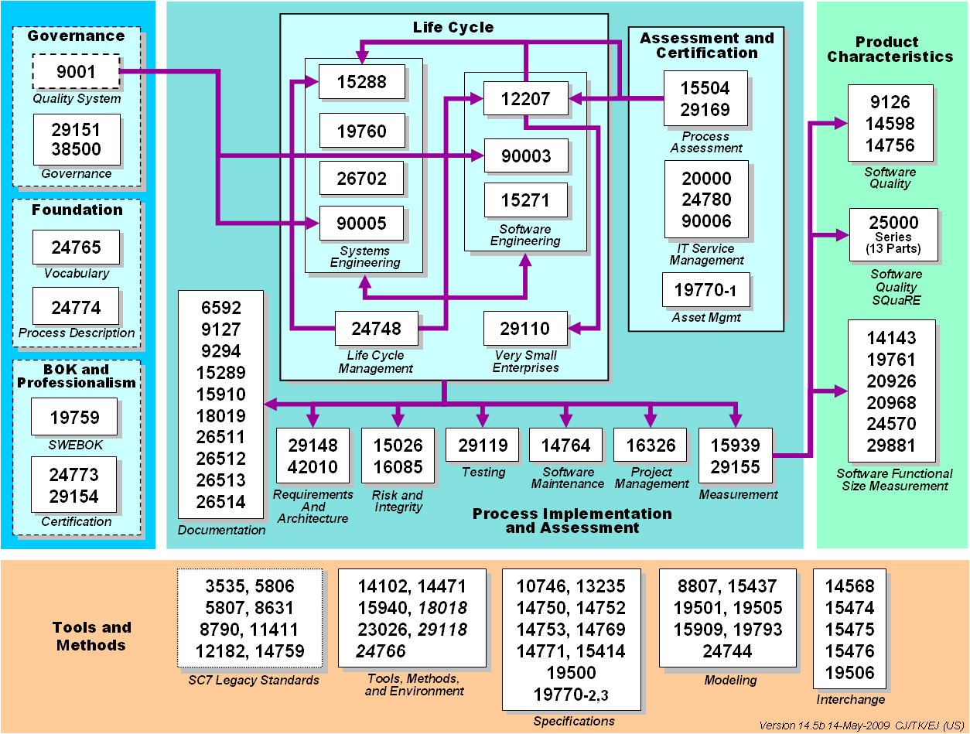
JTC 1 SC7 Standards Collection

Slide 23
Course Topics
Why are Standards are important?
What is ISO/IEC?
What ISO/IEC Standards are available?
ISO 9000
ISO 12207
ISO 15504

Slide 24
ISO 9000 Philosophy
Document what you do
  in conformance with the requirements of the applicable standard
Do what you document
Record what you did
Prove it
  maintenance of registration requires audits every three years, with mini-audits every six months

Slide 25
The ISO 9000 Family
ISO 9000 is a family of standards for quality management systems
Originated in manufacturing, they are now employed across a wide range of other types of organizations
Some of the requirements in ISO 9001 (which is one of the standards in the ISO 9000 family) include
  a set of procedures that cover all key processes in the business;
  monitoring processes to ensure they are effective;
  keeping adequate records;
  checking output for defects, with appropriate corrective action where necessary;
  regularly reviewing individual processes and the quality system itself for effectiveness; and
  facilitating continual improvement

Slide 26
What is in the ISO 9000 Family
ISO 9000-1 is a general guideline which gives background information about the family of standards
ISO 9001, ISO 9002, and ISO 9003 are standards in the family, containing requirements on a supplier
ISO 9002 and ISO 9003 are subsets of ISO 9001
  ISO 9002 applies when there is no design
  ISO 9003 applies when there is neither design nor production
ISO 9004 is a comprehensive guideline to the use of the ISO 9000 standards
For software development, ISO 9001 is the standard to use
ISO 9000-3 is a guideline on how to use ISO 9001 for software development
ISO 9004-2 is a guideline for the application of ISO 9001 to the supply of services (including computer centers and other suppliers of data services)

Slide 27
ISO 9000 Structure
ISO 9000
ISO 9002
Quality System Model for Quality Assurance in production, installation, and servicing
ISO 9003
Quality System Model for Quality Assurance in final inspection and test
ISO 9001
Quality System Model for Quality Assurance in design, development, production, installation and service
ISO 9000-3
Guidelines for the application of ISO 9001 to the design, development and maintenance of software

Slide 28
Quality management
ISO 9001 is for quality management.
Quality refers to all those features of a product (or service) which are required by the customer.
Quality management means what the organization does to
  ensure that its products or services satisfy the customer's quality requirements and
  comply with any regulations applicable to those products or services.
Quality management also means what the organization does to
  enhance customer satisfaction, and
  achieve continual improvement of its performance

Slide 29
Generic standard
ISO 9001 is a generic standard
Generic means that the same standards can be applied:
  to any organization, large or small, whatever its product or service,
  In any sector of activity, and
  whether it is a business enterprise, a public administration, or a government department.
Generic also signifies that signifies that
  no matter what the organization's scope of activity
  if it wants to establish a quality management system, ISO 9001 gives the essential features

Slide 30
Management systems
Management system means what the organization does to manage its processes, or activities in order that
  its products or services meet the organization’s objectives, such as
  satisfying the customer's quality requirements,
  complying to regulations
Everyone is clear about who is responsible for doing what, when, how, why and where.
Management system standards provide the organization with an international, state-of-the-art model to follow.

Slide 31
Processes, not products
ISO 9001 concern the way an organization goes about its work
  Its not a product standard
  Its not a service standard
  It’s a process standard
It can be used by product manufacturers and service providers.
Processes affect final products or services.
ISO 9001 gives the requirements for what the organization must do to manage processes affecting quality of its products and services

Slide 32
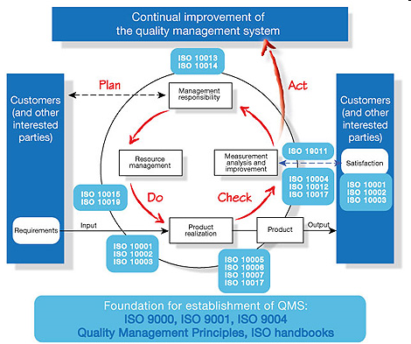
ISO 9000 Process model

Slide 33
ISO 9000 and Quality Management
ISO9000
quality models
is instantiated as
Organization
quality process
Organization
Quality manuals
For assessment
Is used to develop
Project 1
Quality plan
Project 2
Quality plan
Project 3
Quality plan
Project quality
management
supports

Slide 34
Certification and registration
Certification is known in some countries as registration.
It means that an independent, external body has audited an organization's management system and verified that it conforms to the requirements specified in the standard (ISO 9001 or ISO 14001).
ISO does not carry out certification and does not issue or approve certificates,

Slide 35
Accreditation
Accreditation is like certification of the certification body.
It means the formal approval by a specialized body - an accreditation body - that a certification body is competent to carry out ISO 9001 certification in specified business sectors.
Certificates issued by accredited certification bodies - and known as accredited certificates - may be perceived on the market as having increased credibility.
ISO does not carry out or approve accreditations.

Slide 36
Certification not a requirement
Certification is not a requirement of ISO 9001
The organization can implement and benefit from an ISO 9001 system without having it certified
The organization can implement them for the internal benefits without spending money on a certification programme

Slide 37
Certification is a business decision
Certification is a decision to be taken for business reasons:
  if it is a contractual, regulatory, or market requirement,
  If it meets customer preferences
  it is part of a risk management programme, or
  if it will motivate staff by setting a clear goal.

Slide 38
ISO does not certify
ISO does not carry out ISO 9001 certification
ISO does not issue certificates
ISO does not accredit, approve or control the certification bodies
ISO develops standards and guides to encourage good practice in accreditation and certification

Slide 39
Certification Process
Make commitment
Select Registrar
Apply for registration
Conduct initial assessment/doc review
Conduct full assessment
Perform pre/internal assessment audit
Make improvements/take corrective action
Enter surveillance mode

Slide 40
Course Topics
Why are Standards are important?
What is ISO/IEC?
What ISO/IEC Standards are available?
ISO 9000
ISO 12207
ISO 15504

Slide 41
ISO/IEC 12207
Is an international software engineering standard that defines the software engineering process, activity, and tasks that are associated with a software life cycle process from conception through retirement
The standard has the main objective of supplying a common structure so that the buyers, suppliers, developers, maintainers, operators, managers and technicians involved with the software development use a common language
It aims to be 'the' standard that defines all the tasks required for developing and maintaining software

Slide 42
What is it?
A standard for software lifecycle processes
A standard that provides a common framework to speak the same language in software discipline.
  For the first time - a world-wide agreement on what activities make up a software project
The processes in the life cycle of software
  High level process architecture
  Activities and tasks
  Tailored for any organization or project
  An ‘inventory’ of processes from which to choose

Slide 43
What is it NOT?
NOT a standard for product
  Does not measure the quality of the product
NOT prescriptive
  Does not say specifically how to do things
NOT a standard for methods
  Does not prescribe to specific lifecycle or tools

Slide 44
ISO 12207
Standard ISO 12207 establishes a process of life cycle for software, including processes and activities applied during the acquisition and configuration of the services of the system
  Each Process has a set of outcomes associated with it.
  There are 23 Processes, 95 Activities, 325 Tasks and 224 Outcomes

Slide 45
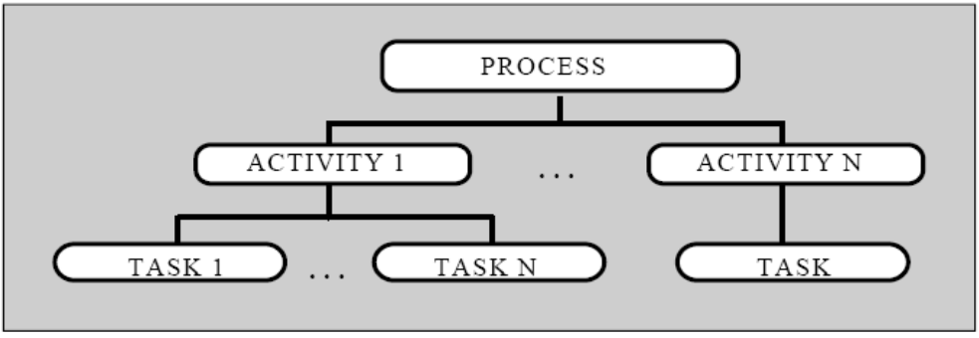
ISO 12207 Process Architecture
Purpose
  high level objective of performing the process and the likely outcomes of effective implementation of the process
Outcomes
  An achievable result of the successful achievement of the process purpose
  224 outcomes
Process
  a set of related activities, which transform inputs to outputs
  25 processes (18 + 7 new)
Activity
  detailed set of tasks
  95 Activities
Task
  action which inputs and outputs
  325 tasks

Slide 46
Software life cycle processes
PRIMARY PROCESSES
SUPPORTING PROCESSES
Development
  System analysis and design
  Software requirements analysis
  Software design
  Software implementation
  Software integration
  Software testing
  System integration and testing
Acquisition
  Acquisition Preparation
  Supplier selection
  Supplier management
  Customer acceptance
Documentation
Configuration Management
Supply
Quality Assurance
Verification
Validation
Joint Review
Audit
Requirements elicitation
Operation
  System operation
  Customer support
Maintenance
Problem Resolution
ORGANISATIONAL PROCESSES
Infrastructure
Management
Organisational alignment
Human Resource Management
Project Management
Improvement
  Process establishment
  Process assessment
  Process improvement
Quality Management
Measurement
Risk Management
Reuse

Slide 47
Sub-processes
Process
implementation
Requirements
elicitation
Project
Software
installation
Software
acceptance
support
System
requirements
analysis
System
architectural
design
System
System
integration
System
testing
Software
requirements
analysis
Software
Software
testing
Software
design
Software
integration
Software
construction

Slide 48
Sub-processes
For example…
  Some Sub-Processes in more detail
    Process implementation
    Requirements elicitation
    System requirements analysis

Slide 49
Process implementation
Define or select software life cycle model appropriate to the scope, magnitude, and complexity of the project;
Select, tailor, and use standards, methods, tools, and programming languages (if not stipulated in contract);
Develop plans for conducting the activities of the Development process.

Slide 50
Requirements elicitation
Purpose:
  to gather, process, and track evolving customer needs and requirements throughout the life of the product and/or service so as to establish a requirements baseline that serves as the basis for defining the needed work products.
  Requirement elicitation may be performed by the acquirer or the developer of the system.
Tasks:
  Obtain customer requirements and requests
  Review to Understand customer expectations
  Agree on requirements
  Establish customer requirements baseline
  Manage customer requirements changes
Outputs:
  Customer requirements;
  Change request records.

Slide 51
System requirements analysis
Purpose:
  to transform the defined stakeholder requirements into a set of desired system technical requirements that will guide the design of the system.
Tasks:
  Establish system requirements
  Establish and maintain traceability
  Verify system requirements
  Baseline and communicate system requirements
Outputs:
  System requirements; Interface requirements;
  Traceability record
  Verification report

Slide 52
Course Topics
Why are Standards are important?
What is ISO/IEC?
What ISO/IEC Standards are available?
ISO 9000
ISO 12207
ISO 15504

Slide 53
What is it?
ISO/IEC 15504, also known as SPICE (Software Process Improvement and Capability Determination), is a framework for the assessment of processes

Slide 54
Process Assessment
An appraisal or review of an organisations software process
  The disciplined examination of the processes by an organisation against a set of criteria to determine capability of those processes to perform within quality, cost and schedule goals
It helps organisations improve themselves by identifying their critical problems and establishing improvement priorities
Not an end in itself
Feeds to an improvement plan

Slide 55
Why perform an assessment?
To understand and determine the organisations current software engineering practices and to learn how the organisation works
To identify strengths, major weaknesses and key areas for SPI
Facilitate the initiation and planning of SPI activities and enrol leaders in change process
To help obtain sponsorship and support for actions through following a participative approach to assessment
External factors - requirement to have an “official” maturity level rating
When you start working with improvement you need to know
  the state of the organisations current software process
  and the goals for the future
  You also need to know whether you have reached your goals when the planned improvement activities are finished

Slide 56
Contexts for Process Assessment
Process
Is
subjected
to
Identifies
changes to
Process
Assessment
Identifies
suitability of
leads
to
leads
to
Process
Improvement
Capability
Determination
may lead to

Slide 57
The International Standard
Part 1
Concepts and Vocabulary
Part 3
Guidance on Performing Assessments
Part 4
Guidance on Using Assessment Results
Part 2
Requirements
(normative)
Compliant Process Reference Model (ISO/IEC 12207 AMD 1/2)
Part 5
An Exemplar Assessment Model
Notes:
There are five parts in ISO 15504, down from nine parts in the TR version. In presenting this, make the point that the standard requires the use of an external Process Reference Model for its application, and that ISO 12207 Amd 1 fills this role for Part 5. This relationship will be explained in m,ore detail as the course progresses.
Point out “normative” and explain what it means – that one part (P2) contains all of the requirements for assessment – all the things that are required to be done.

Slide 58
The Process Assessment Process
PROCESS ASSESSMENT MODEL
Scope
Indicators
Mapping
Translation
PROCESS REFERENCE MODEL
Domain and Scope
Process Purpose
Process Outcomes
MEASUREMENT FRAMEWORK
Capability Levels
Process Attributes
Rating Scale
ASSESSMENT PROCESS
Planning
Data Collection
Data Validation
Process Attribute Rating
Reporting
INPUT
Sponsor identity
Purpose
Scope
Constraints
Assessment Team
OUTPUT
Identification of Evidence
Process Used
Process Profiles
ROLES AND RESPONSIBILITIES
Sponsor
Competent Assessor
Assessors

Slide 59
The Assessment Framework
Two-dimensional model for processes and process capability
  Process Dimension
    Process Categories
    Processes (P1, …, Pn)
  Capability Dimension
    Capability Levels (CL1, …, CL5)
    Process Capability Attributes
Each process receives a capability level rating
CL5
CL5
CL4
CL4
CL3
CL3
CL2
CL2
CL1
CL1
CL0
CL0
CUS.1 CUS.2...ORG.6

Slide 60
A Measurement Scale of Capability
Process capability is defined on a six point ordinal scale of measurement
  the bottom of the scale: the Incomplete Process
    Performance that is not capable of fulfilling its goals
  the top of the scale: the Optimising Process
    Performance that is capable of meeting its goals and sustaining continuous process improvement
The scale represents increasing capability of the process

Slide 61
ISO/IEC 15504-5: Processes
Acquisition
Acquisition preparation
Supplier selection
Contract agreement
Supplier monitoring
Product acceptance
Configuration Control
Documentation management
Configuration management
Problem resolution management
Change request management
Management
Organisational alignment
Organisational management
Project management
Quality management
Risk management
Measurement
Supply
Supplier tendering
Product release
Product acceptance support
Product Quality
Product evaluation
Process Improvement
Process establishment
Process assessment
Process improvement
Quality Assurance
Quality assurance
Verification
Validation
Joint review
Audit
Engineering
Requirements elicitation
System requirements analysis
System architectural design
Software requirements analysis
Software design
Software construction
Software integration
Software testing
Software installation
System integration
System testing
System and software maintenance
Resource and Infrastructure
Human resource management
Training
Knowledge management
Infrastructure
SUPPORTING
ORGANISATIONAL
Reuse
Asset management
Reuse program management
Domain engineering
PRIMARY

Slide 62
The Measurement Framework
Optimizing
The process is continuously improved to meet relevant current and projected business goals
Level 5 Optimizing
PA.5.1 Process Innovation
PA.5.2 Process Optimisation
Predictable
The process is enacted consistently within defined limits
Level 4 Predictable
PA.4.1 Process Measurement
PA.4.2 Process Control
Established
A defined process is used based on a standard process.
Level 3 Established
PA.3.1 Process Definition
PA.3.2 Process Deployment
Level 2 Managed
PA.2.1 Performance Management
PA.2.2 Work Product Management
Managed
The process is managed and work products are established, controlled and maintained.
Level 1 Performed
PA.1.1 Process Performance
Performed
The process is implemented and
achieves its process purpose
Level 0 Incomplete
Incomplete
The process is not implemented or fails to achieve its purpose

Slide 63
The Assessment framework
The formal entry to the assessment processes occurs with the compilation of the assessment input
  This defines the purpose of the assessment (why it is being carried out), the scope of the assessment (which processes are to be assessed) and what constraints, if any, apply to the assessment
An assessment is carried out by assessing selected processes against the process model
The assessment output includes a set of process capability level ratings for each process instance assessed.
An assessment is supported by an assessment instrument
  The process assessment is carried out either by a team with at least one qualified assessor; or, on a continuous basis using suitable tools for data collection and verified by a qualified assessor.

Slide 64

The Assessment Framework
Process
Assessment
Model
Process
Reference
Model
Assessment
Tool
Output
Input
- Purpose
- Scope
- Constraints
5
Process
Assessment
4
3
2
1
Assessor
Training
Syllabus & Certification Scheme
Process Improvement or Capability Determination
Guidance
Responsibilities
Competent Assessor
Sponsor
Assessors
Competent
Assessors

Slide 65
The Assessment Model
ISO 15504-2
Requirements
determine applicability of
for Conformity
(Compatibility)
Process
Measurement
Assessment
Reference
Framework
Model
Model
e.g.
ISO 12207
Requirements
for Compliance
determine suitability of

Slide 66
Process Assessment Models
A Process Assessment Model forms the basis for the collection of evidence and rating of process capability.
Any Process Assessment Model is related to one or more Process Reference Models.
A Process Assessment Model shall contain:
  a definition of its purpose, scope, elements and indicators;
  its mapping to the Measurement Framework and the specified Process Reference Model(s);
  a mechanism for consistent expression of results.

Slide 67
Why the concern for Conformance?
Results from assessments based on the same assessment model can generally be compared in some way.
The requirements for conformance of assessment models broadens the basis for comparison:
  assessments based on different assessment models can be compared, providing the models can be related to the same Process Reference Model.

Slide 68

Process Reference Models
15504
Requirements
REQUIREMENTS
Performing an assessment
Process Reference Models
Process Assessment Models
Conformity assessment
Model
Architecture
Process
Categories
Capability
Levels
Process
Reference
Model
Processes
Process
Attributes
requirements
15504
Assessment
Model
OOSPICE
Automotive
SPICE
ISO 9001
S9K

Slide 69
Acronyms
  A Agreed (Comment Resolution)
  AG Advisory Group
  AH Ad hoc (groups)
  AIP Agreed in Principle (Comment Resolution)
  AMD Amendment
  CD Committee Draft
  C/HOD Convenor/Head of Delegation
  CIF Common Industry Format
  D Deferred (Comment Resolution)
  DCOR Draft Corrigenda
  DIS Draft International Standard
  DTR Draft Technical Report
  E Editorial (Comment Resolution)
  FCD Final Committee Draft
  FDIS Final Draft International Standard
  FDAM Final Draft Amendment
  FPDAM Final Proposed Draft Amendment
  FPDISP Final Proposed Draft International Standardized Profile
  FT Fast-Track
  FTDIS Fast-Track Draft International Standard
  GE General Editorial (Comment Resolution)
  GT General Technical (Comment Resolution)
  IS International Standard
  IEC International Electrotechnical Commission
  ISP International Standardized Profile
  ISO International Organization for Standards
  JTC Joint Technical Committee
  JWG Joint Working Group
  NP New Work Item Proposal
  OBE Overtaken by Events (Comment Resolution)
  ODP Open Distributed Processing
  PAS Publicly Available Specification
  PDAM Proposed Draft Amendment
  PDTR Proposed Draft Technical Report
  PWI Proposed Work Item
  R Reject (Comment Resolution)
  SC Sub-committee
  SG Sub-Group
  SWG Special Working Group
  TH Technical High (Comment Resolution)
  TL Technical Low (Comment Resolution)
  TR Technical Report
  TS Technical Specification
  W Withdrawn (Comment Resolution)
  WD Working Draft (Working Group Draft)
  WG Working Group

Slide 70
Information Links
SC7 website
  http://www.jtc1-sc7.org/
Procedures for the technical work of ISO/IEC JTC 1 on Information Technology (Ed.5) takes precedence over the ISO directives for Standards Development
  http://isotc.iso.org/livelink/livelink.exe/fetch/186605/customview.html?func=ll&objId=186605&objAction=browse&sort=name
ISO Directive for Standards Development
  http://isotc.iso.org/livelink/livelink/fetch/2000/2122/3146825/4229629/texts_list.htm
  Part 1 of the ISO/IEC Directives, together with this Supplement, provide the complete set of procedural rules to be followed by ISO committees
    http://isotc.iso.org/livelink/livelink.exe?func=ll&objId=4230452&objAction=browse&sort=subtype
Special procedures, i.e., guidance, associated with the development of standards have been developed based on experience are listed at the following:
  http://isotc.iso.org/livelink/livelink/fetch/2000/2122/3146825/4229629/sds_spec.htm
Procedures for writing standards, ISO/IEC Directives, Part 2, Rules for the structure and drafting of International Standards (Ed.5) and associated guidance is provided at the following:
  http://isotc.iso.org/livelink/livelink/fetch/2000/2122/3146825/4229629/sds_spec.htm
SC7 draft standards balloting information and schedule is available at:
  http://142.137.17.56/Labo_Recherche/Lrgl/sc7/Ballots.html
Notes:
Check links
Check whether you need a password to reach these

Slide 71
ISO Document Life Cycle
NP
EXISTING
STANDARD
WD
ISO
Standard
Non-ISO
Standard
CD
PDAM
PDTR
PDISP
Fast track process
FCD
FPDAM
FPDISP
FDIS
FDAM
DTR
FDISP
DCOR
DIS
IS
AMD
TR
ISP
COR
IS
NP = New work item Proposal
WD = Working Draft
CD = Comittee Draft
FCD = Final Comittee Draft
FDIS = Final Draft International Standard
IS = International Standard
TR = Technical Report
SC7 develops
SC7 controls
ISO controls
ISO edits and publishes
Adapted from: SC7 Secretariat Training for ISO Editors, Hyderabad 2009

Slide 72
Evolution of SC7 Portfolio
110
100
90
Standards Published
80
Standards Maintained
70
60
50
40
30
20
10
0
1987
1989
1991
1993
1995
1997
1999
2001
2003
2005
2007
2009

